Slide 1
AI- Powered Code Analysis and Review System
Project Presentation
Submitted By:
Prashansa Shandilya
Course : B.Tech- CSE(AIML)
Batch- 3

Slide 2
Introduction
Code review is an essential part of software development that helps identify bugs, improve code quality, and maintain coding standards. However, manual code reviews can be time-consuming and may miss potential issues. The AI Code Reviewer is a web-based application that uses Google's Gemini AI to automatically analyze Python code and provide intelligent feedback. It detects errors, suggests optimizations, and recommends best coding practices to improve code readability and performance. Built using Flask for the backend and a responsive web interface, the system offers developers quick and reliable code reviews, making the development process more efficient

Slide 3
Technologies Used
Python – Core programming language used for developing the AI Code Reviewer.
Flask – Backend web framework used to handle user requests and integrate the AI model.
Google Gemini API – AI model used to analyze Python code, detect bugs, and generate improvement suggestions.
HTML5 – Created the structure of the web application's user interface.
CSS3 – Designed a clean, responsive, and user-friendly interface.
JavaScript – Added interactivity and managed client-side functionality.
REST API – Enabled communication between the Flask backend and the Gemini AI service.
Git & GitHub – Used for version control, source code management, and project collaboration.

Slide 4
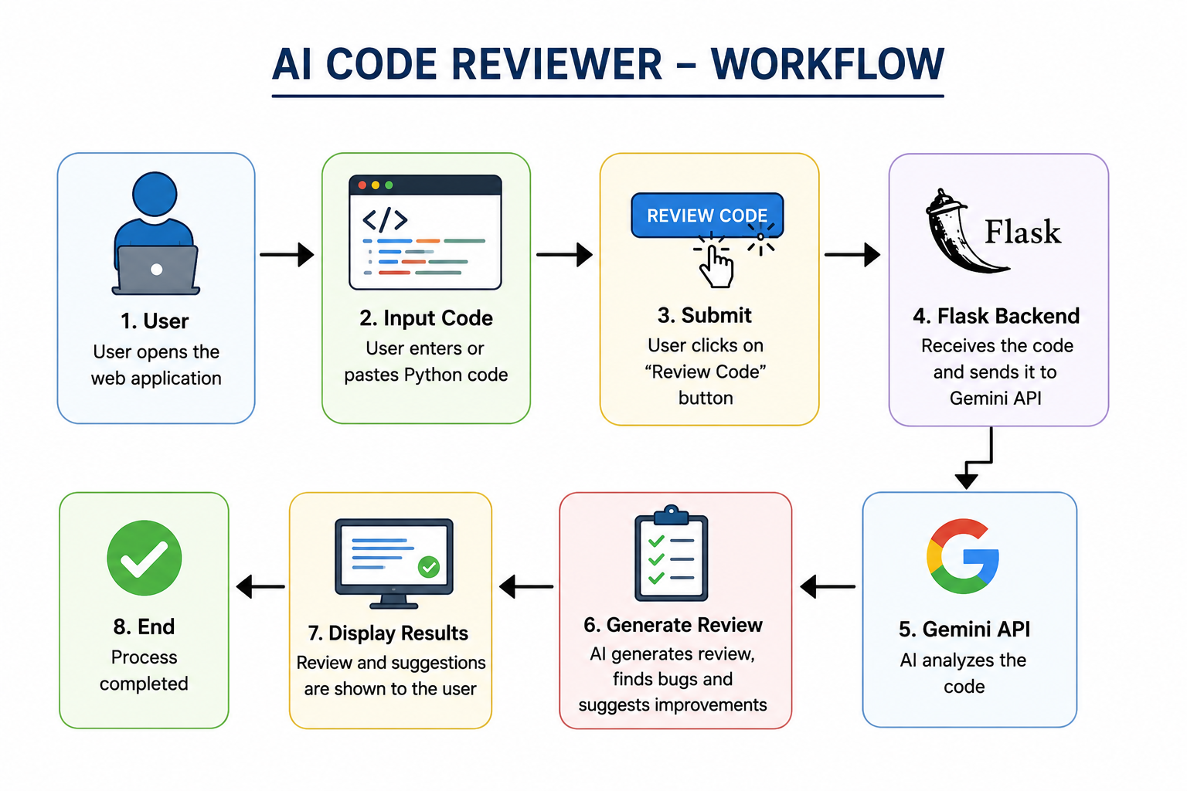

Slide 5
Future Scope
Support Multiple Programming Languages – Extend the system to review Java, C++, JavaScript, and other languages.
Automatic Code Correction – Generate optimized and corrected versions of the submitted code.
GitHub Integration – Enable direct code review for repositories and pull requests.
Security & Performance Analysis – Detect security vulnerabilities and provide performance optimization suggestions.
IDE Integration – Develop plugins for Visual Studio Code and other IDEs to provide real-time code review.

Slide 6
References
Python Official Documentation – https://docs.python.org/3/
Flask Documentation – https://flask.palletsprojects.com/
Google AI for Developers (Gemini API Documentation) – https://ai.google.dev/
HTML, CSS & JavaScript Documentation (MDN Web Docs) – https://developer.mozilla.org/
GitHub Documentation – https://docs.github.com/

